Slide 1
Hi! This Jing.
I put down some of my past projects, coursework and internship accomplishments here, involving controls, mechatronics, mechanics and data mining.
My portfolio GitHub Repo: https://github.com/wwtse/folioS

Slide 2
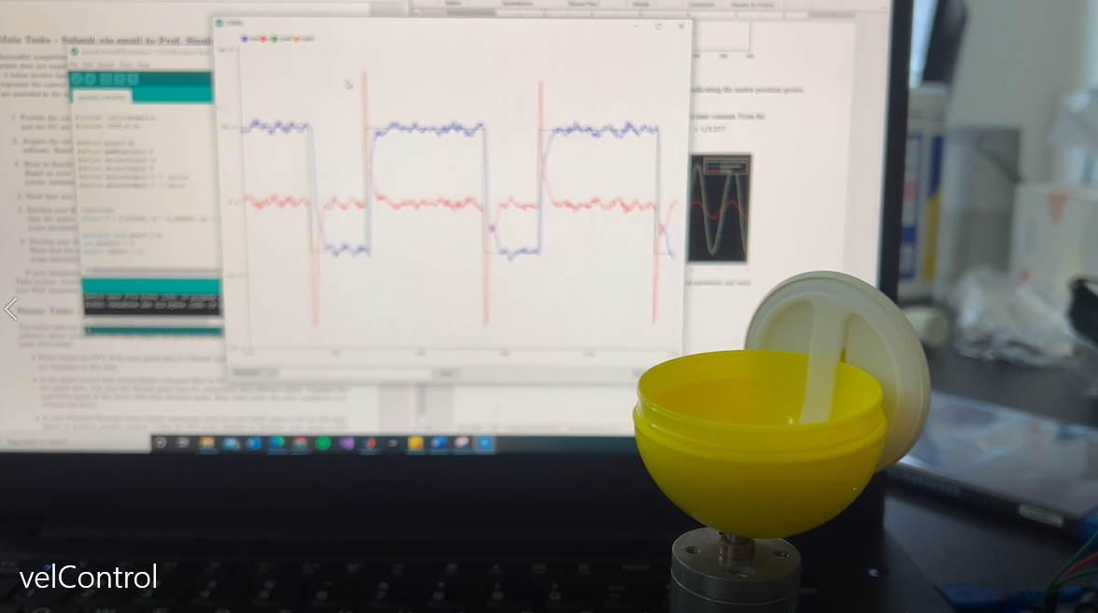
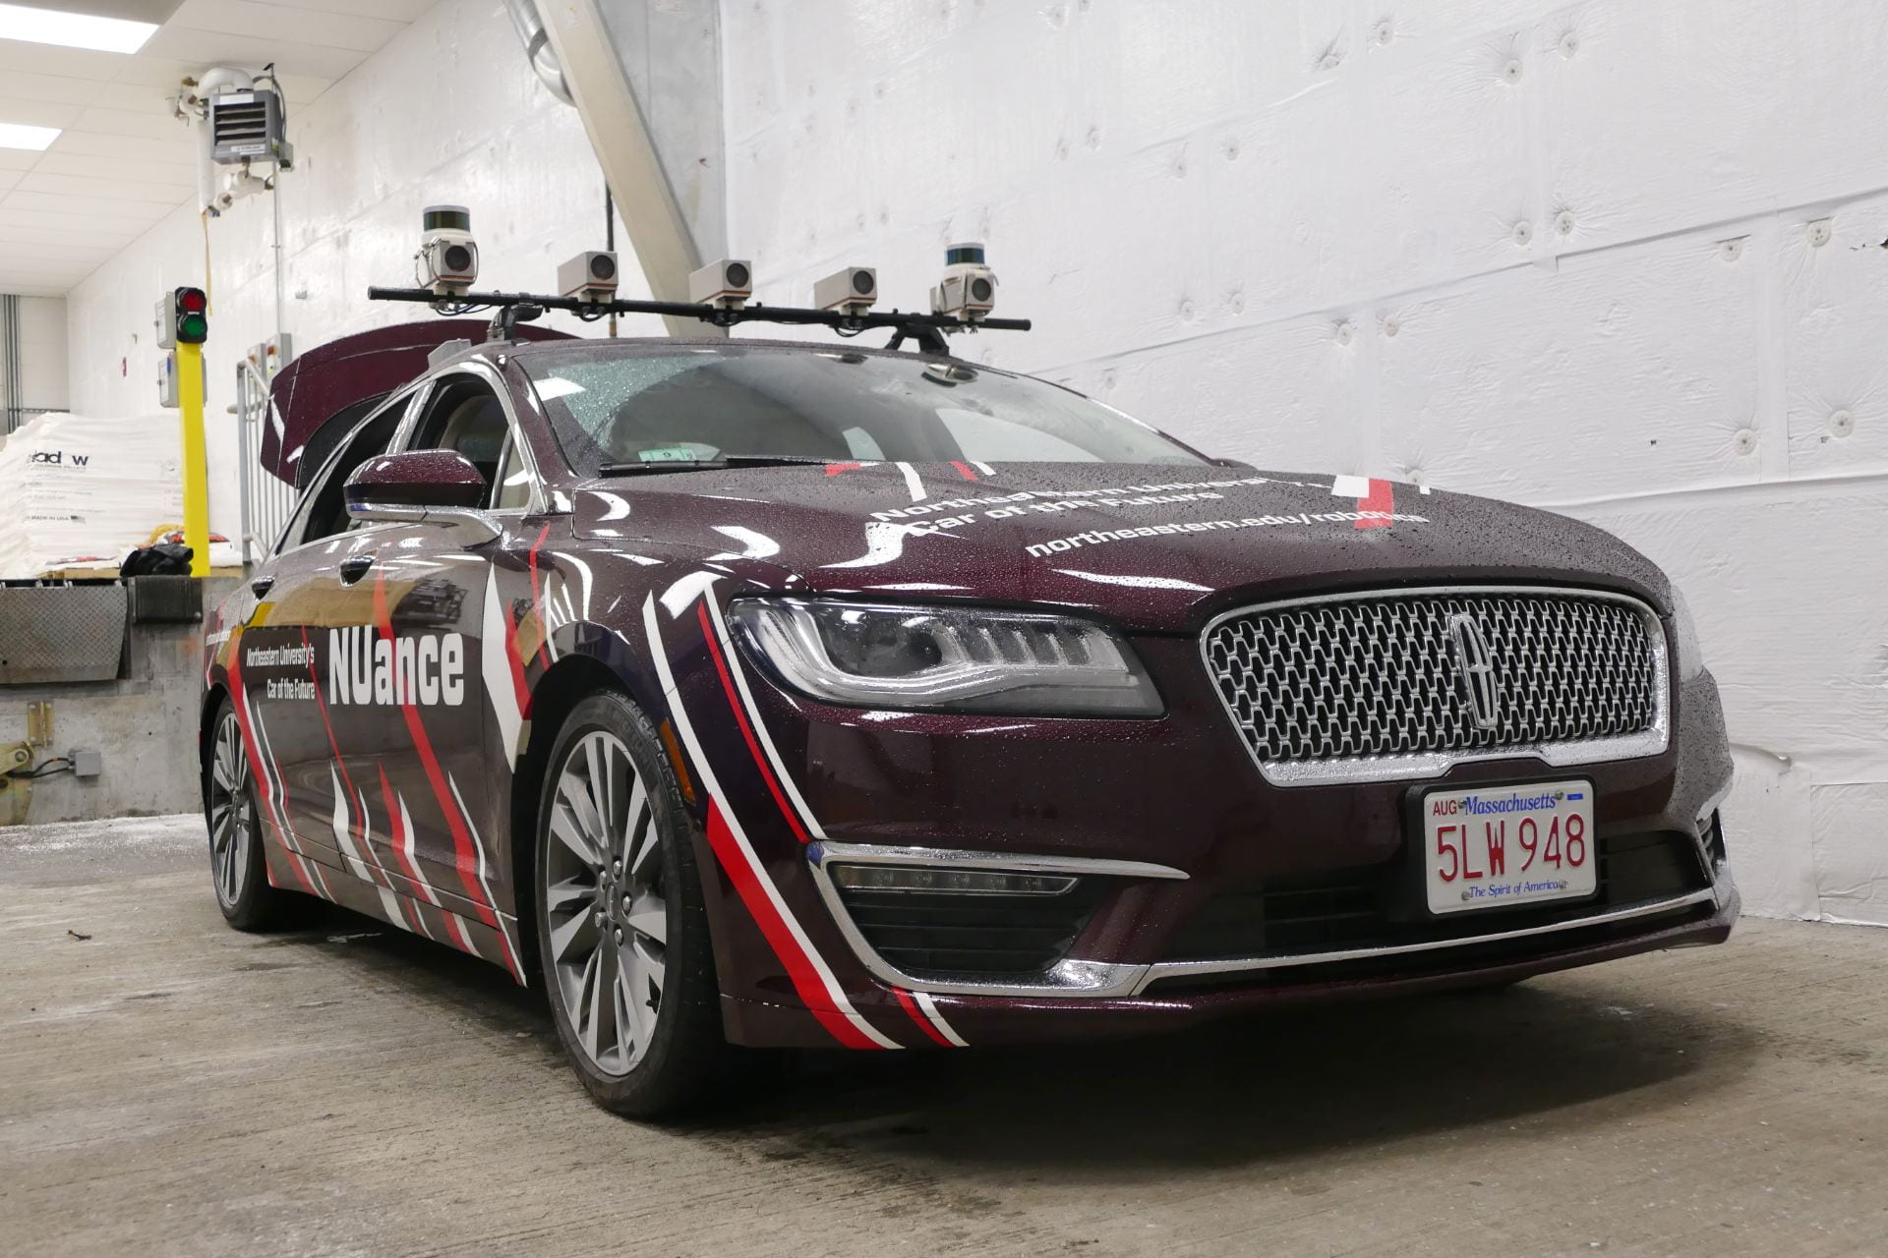
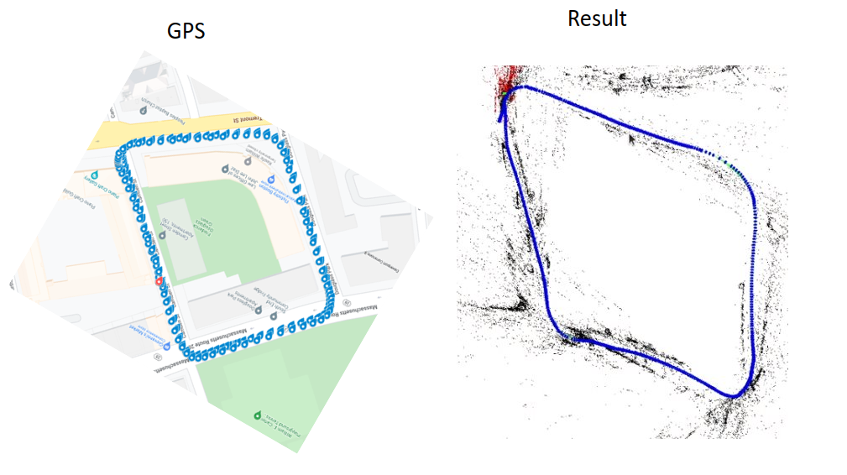
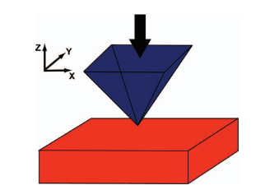
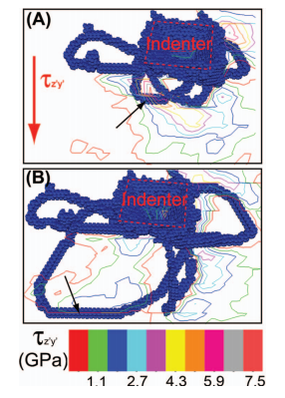
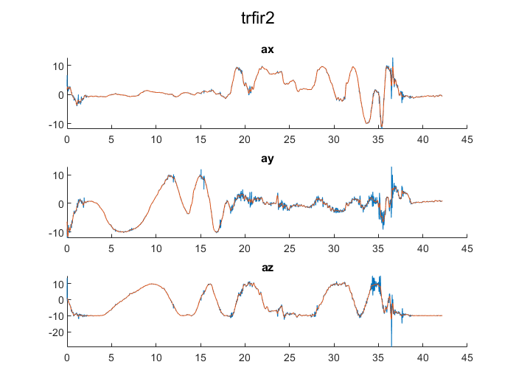
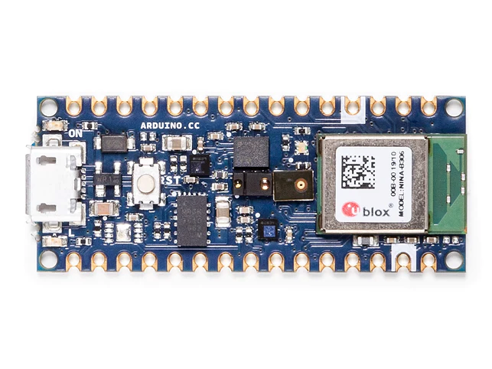
Projects
SLAM
DCmotor control
Nanoindentation
Simulation
IMU filters

Slide 3
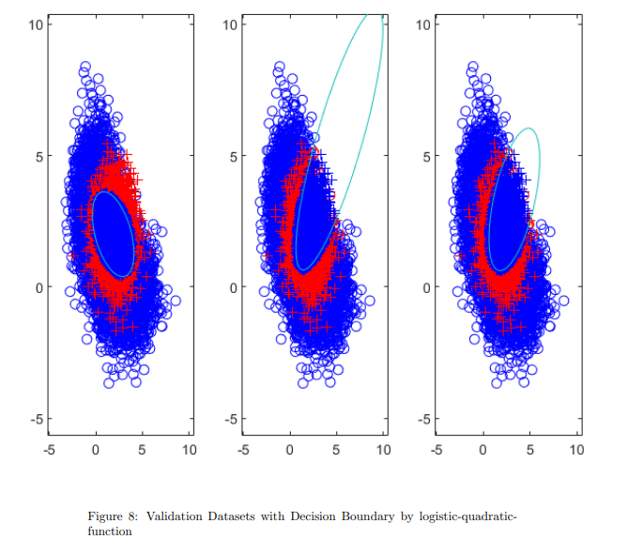
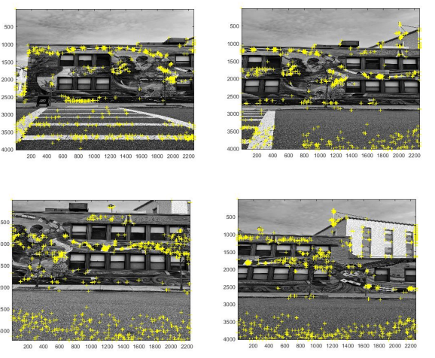
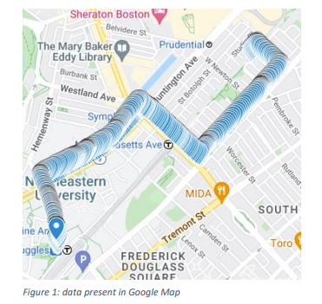
Coursework
Sensor and Navigation
Machine Learning

Slide 4
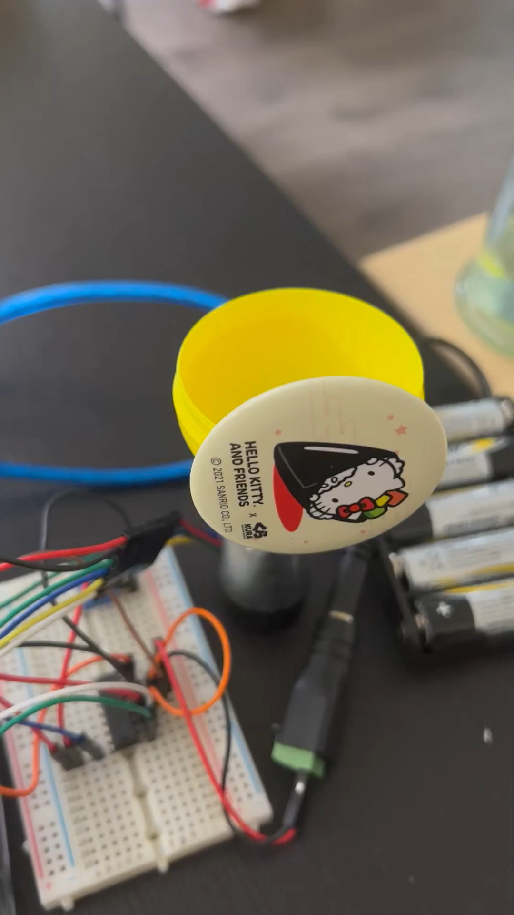
DCmotor Control
Demonstrate motor speed and position control with Arduino IDE and Simulink Real-Time Target.
Video of DC motor position control

Slide 5
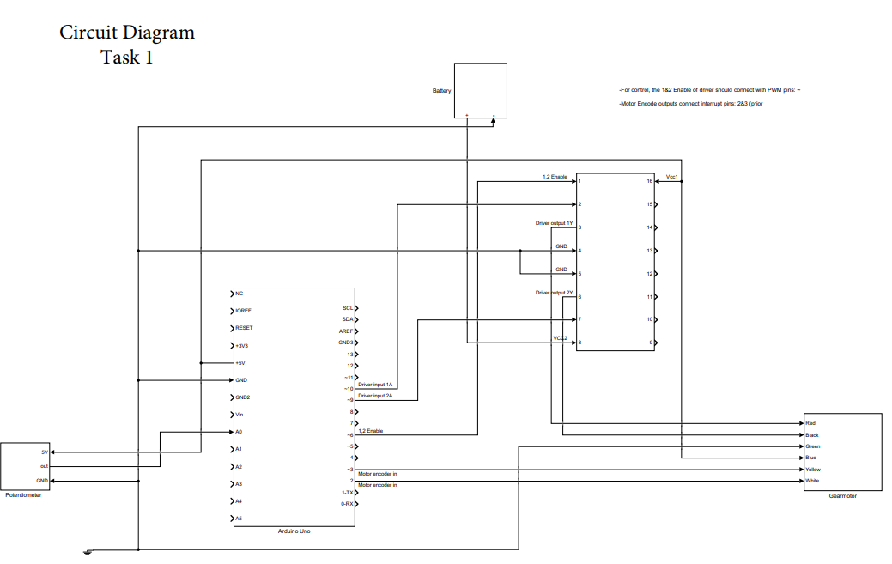
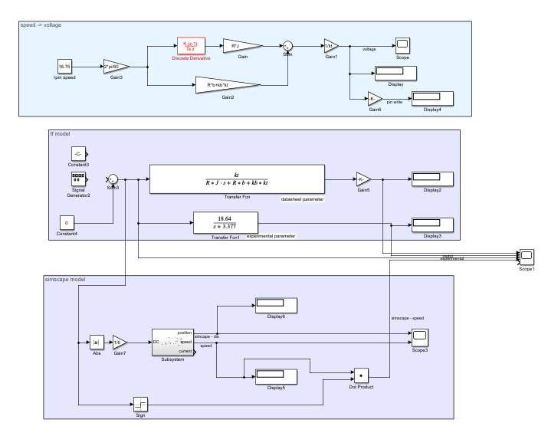
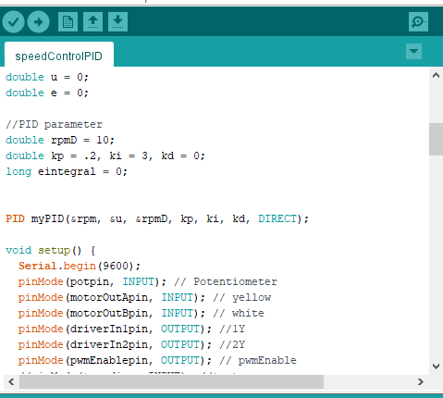
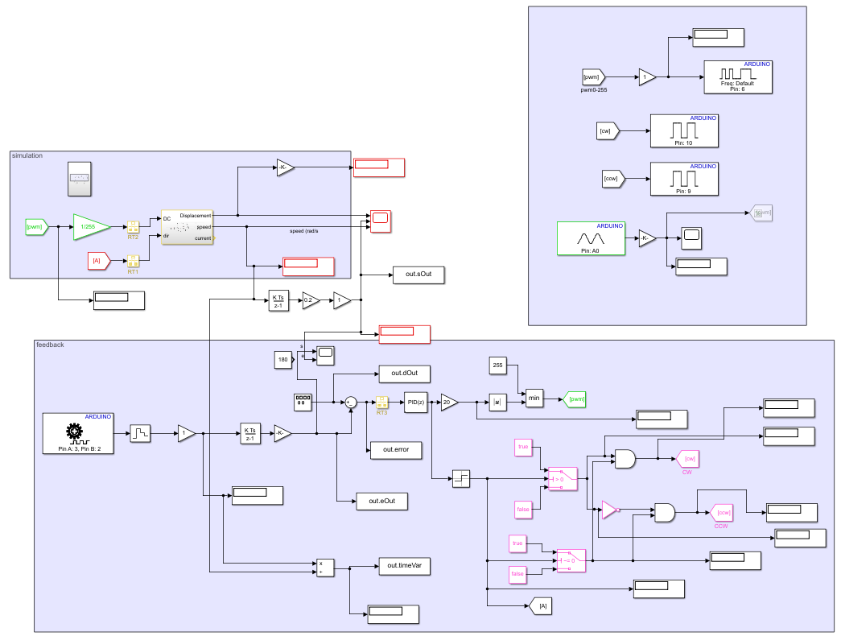
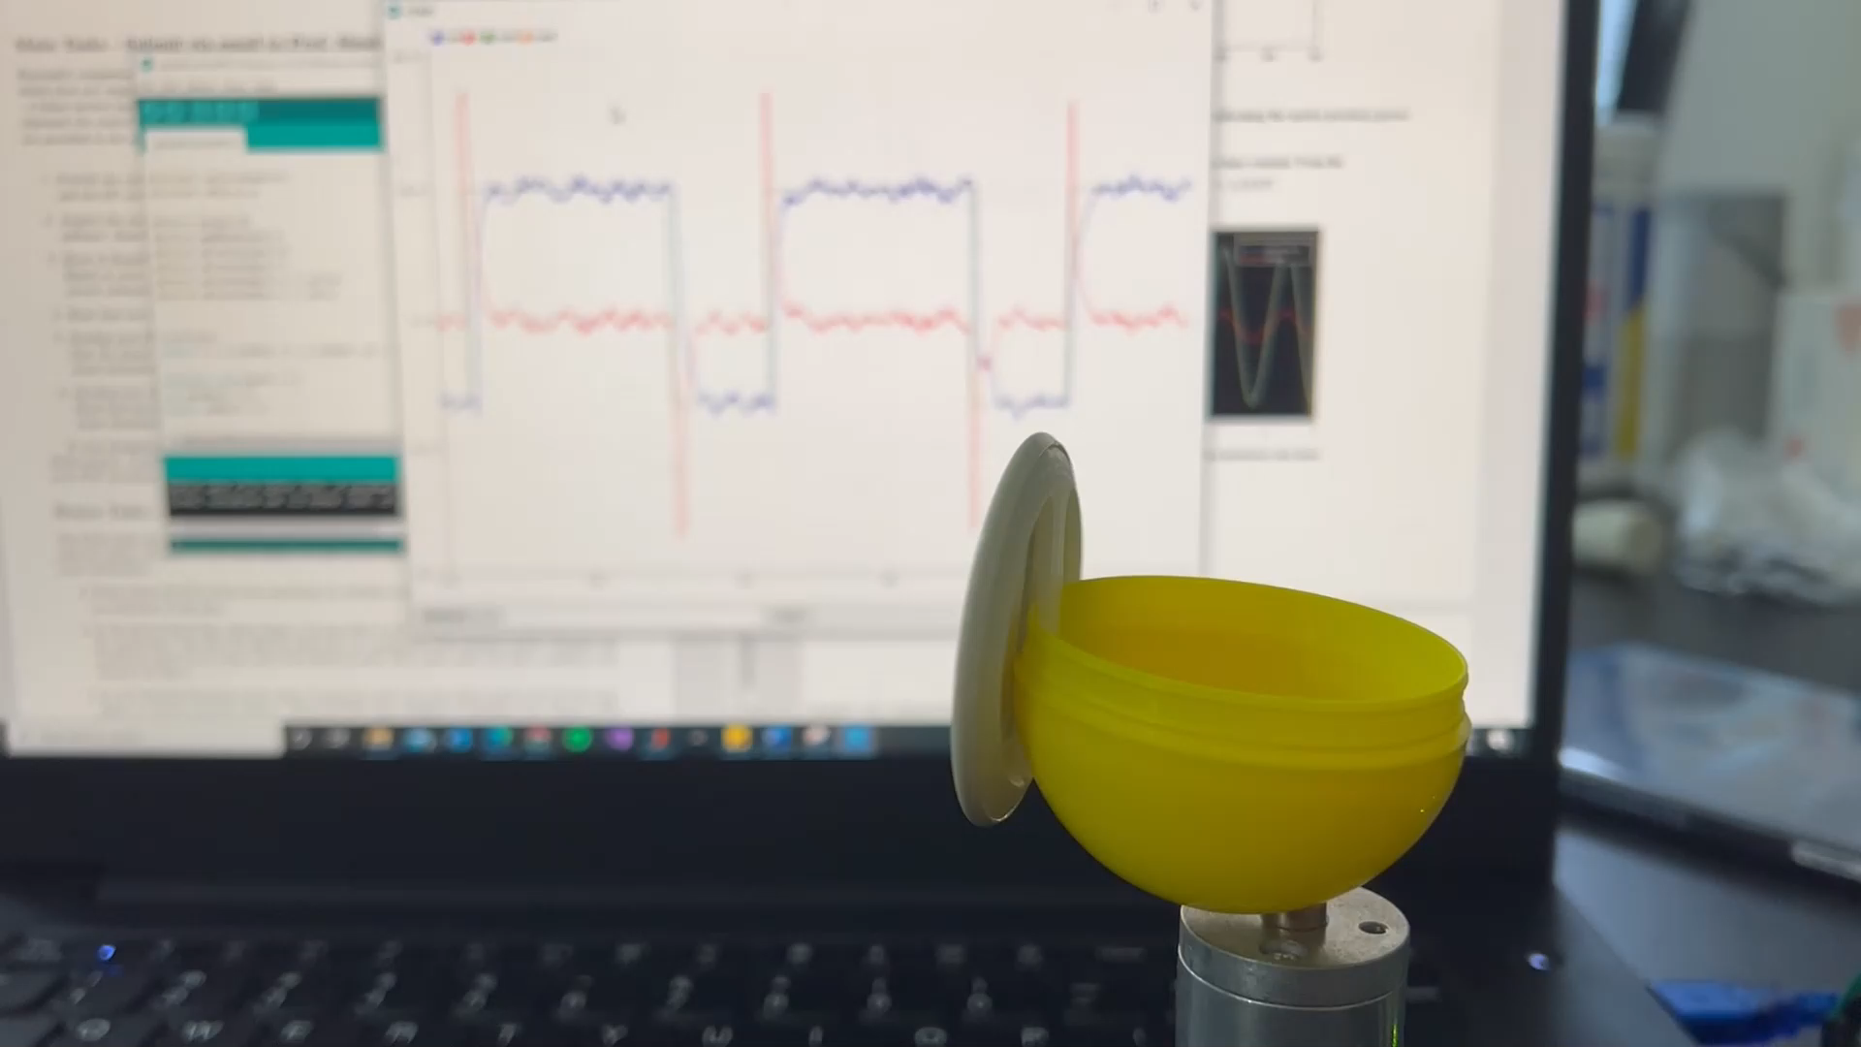
1. Design the circuit diagram
2. Simulation of DC motor with Simulink model
3. One method of motor control with Arduino IDE and C++
4. Another method of motor control with Simulink Real-time Target
Video of DC motor speed control

Slide 6
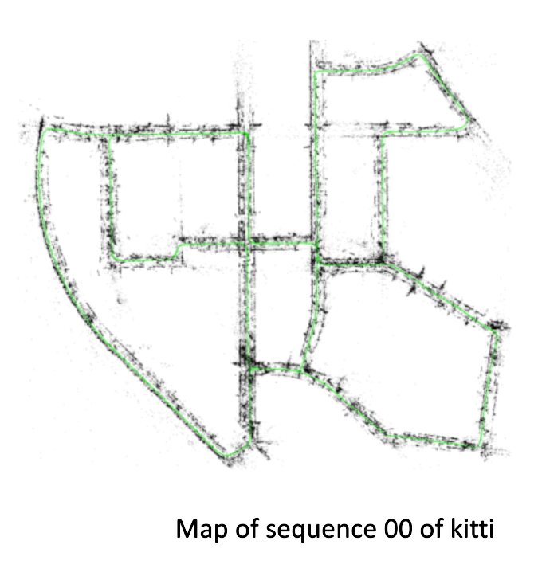
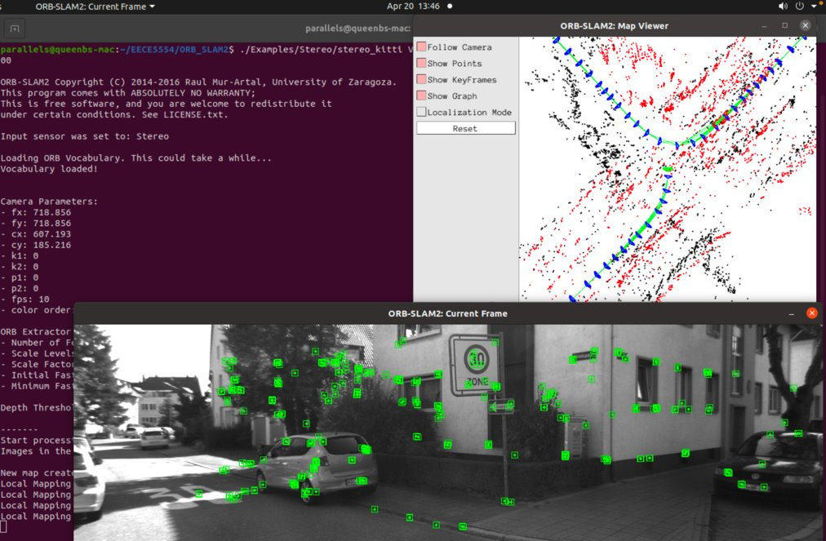
SLAM
SLAM using stereo cameras dataset (kitti and NUance) with ORB-SLAM2 and ROS in Linux system.
The Group Presentation Slides

Slide 7
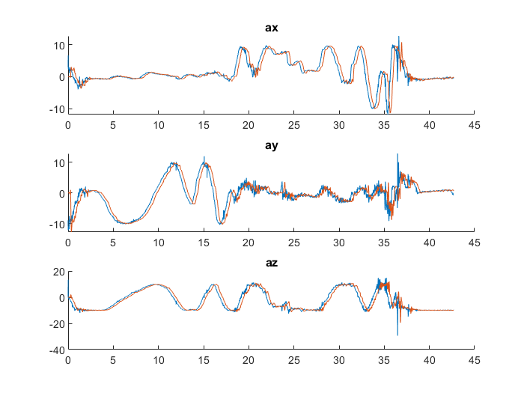
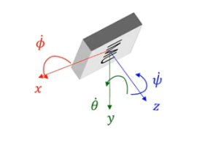
IMU Filters
Filter IMU raw data with the combination of FIR, IIR and complementary filters.

Slide 8
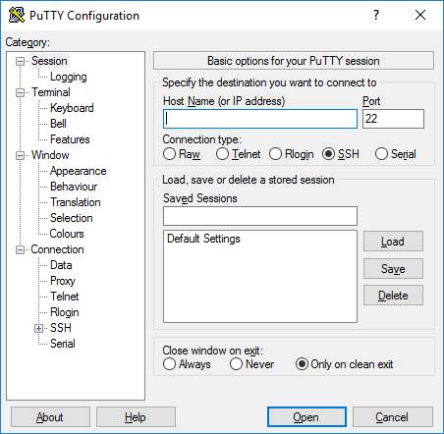
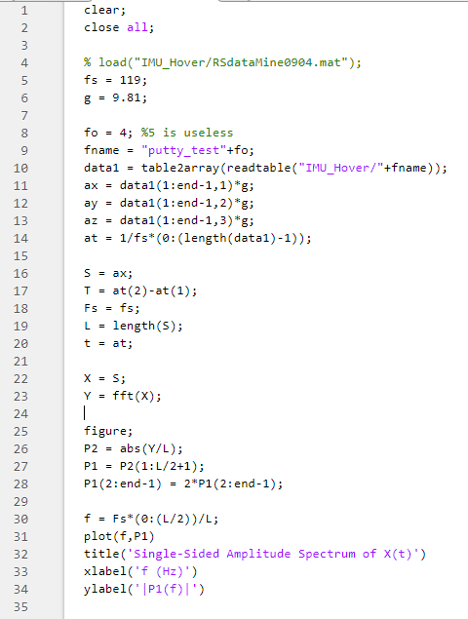
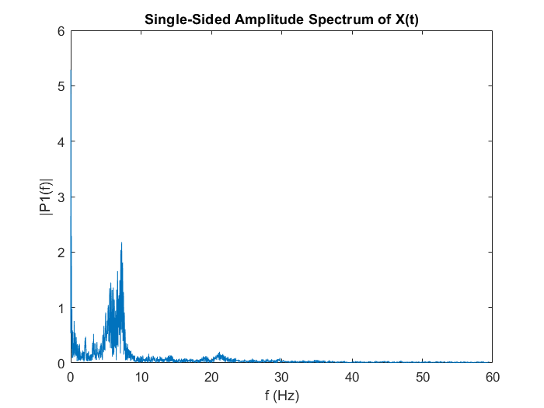
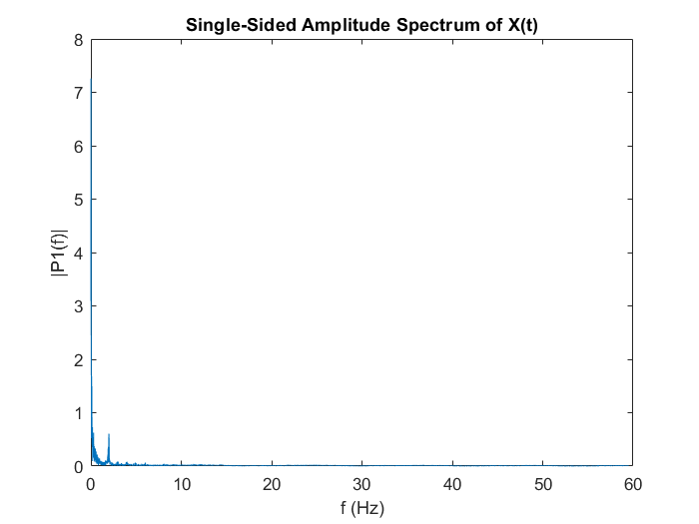
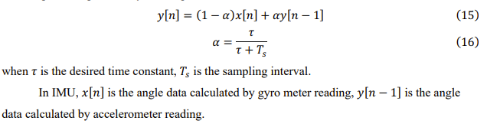
+
1. Datasets source: Parrot Mambo quadcopter and LSM9DS1 IMU. Terminal emulator PuTTY is used to log the signal.
2. Analyze signal with frequency sampling method
3. Low pass filter design with window design method: 4 FIR filters and 1 IIR filter
4. Complementary filter design

Slide 9
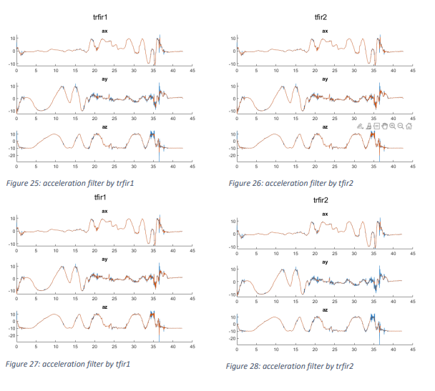
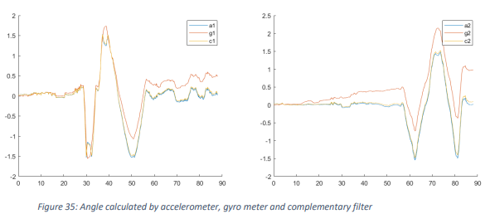
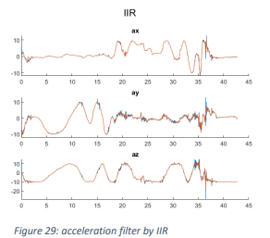
6. Performance of the complementary filter
5. Performance of the low-pass filters

Slide 10
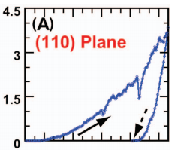
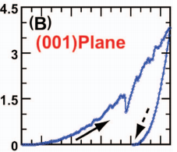
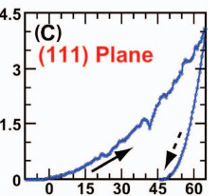
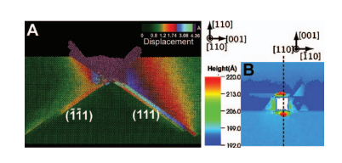
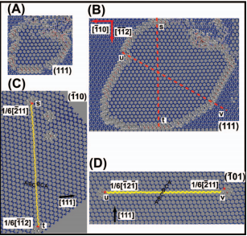
Nanoindentation Simulation
Bachelor Thesis
Multimillion-atom nanoindentation simulation of crystalline silicon carbide with spherical cavity.

Slide 11
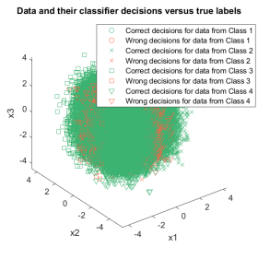
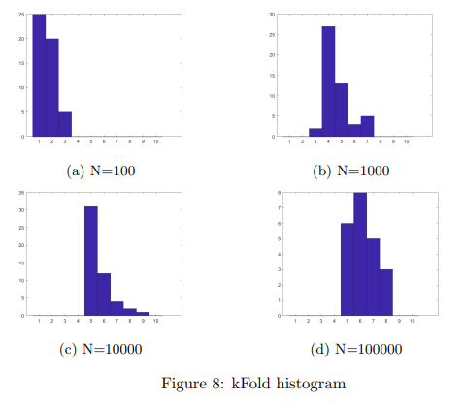
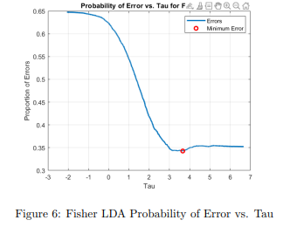
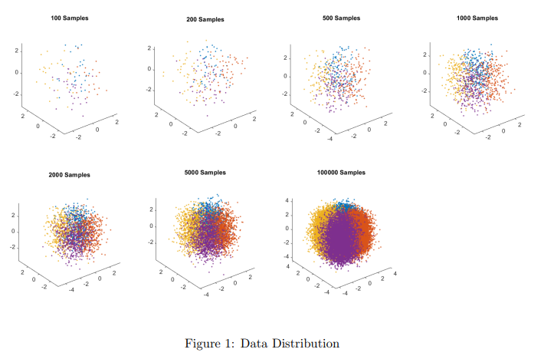
Machine Learning
Used Fisher LDA, ERM, MLE, MAP, Bayesian estimation, BIC and K-fold cross-validation to approximate model parameters. Trained 2-layer MLP.

Slide 12
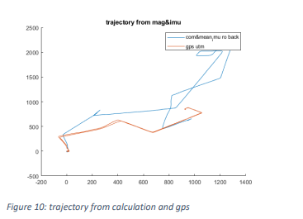
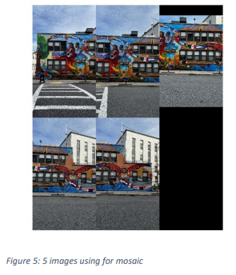
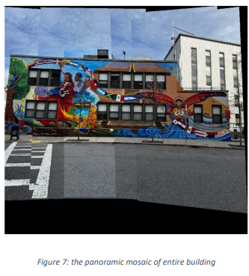
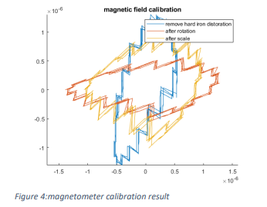
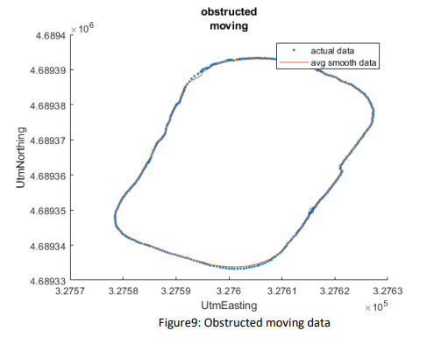
Sensor and Navigation
IMU, GNSS, magnetometer, camera and Lidar.

Slide 13
Internship
Unfortunately, I cannot directly show my work here for some reasons.
Here is the accomplished list of what I have done during my last internship.
BLDC motor control MATLAB simulation without Simulink built-in Toolbox
Drive programming and assist the SW team in familiarizing with the prototype machine
CAN signal capture from i.MX8 and MathWorks Speedgoat
Data Mining for Formative Study with the EM team to troubleshoot from unexpected performance
Electrical schematic review with the EE team
Presentation for internal training
8 pages document of knowledge transfer

